Slide 1
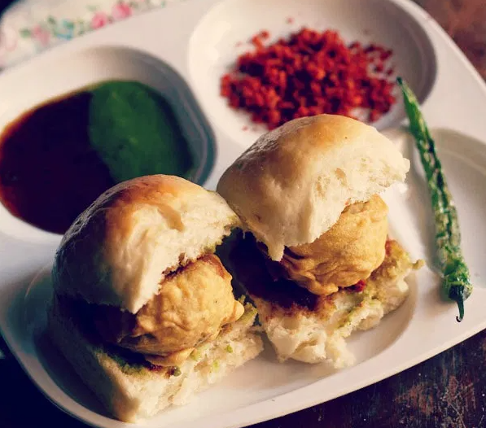
Strategy For New Vada Pav Shop To Compete And Take Over clients
Created By – Aqshata Gade

Slide 2
Agenda
Introduction
Problem Statement & Data Source
Objective & Methodology
Solution Description
Impact

Slide 3
Introduction
New Vada Pav shop near Shivaji Nagar in Pune
Four existing competitor in same location
Considering all factors need to decide a price of Vada Pav
Need to come up with some strategy to bring insights

Slide 4
Problem Statement & Data Source
The shop is going to be new which means no experience.
On the other hand, four competitors with experience are at same location
No data is available for this new shop for analysis which makes it more difficult to bring insights
Decided price of Vada Pav can result in good profit or considerable loss
New shop need to stand out in order to make some profit and to bring customers

Slide 5
Understanding The Problem Statement In Deep Using % Whys Method
Why shop owner need to come up with new best strategy? → Because of high Competition
Why there is high competition? → There are four Vada Pav shops at same location
Why it’s difficult to compete with those four shops? → They have more experience
Why Experience matters? → New shop does not have insights
Why new shop has no insights? → Because of no data as it’s a new shop

Slide 6
Objective & Methodology
To decide the strategy to attract customers considering the profit
Decide price of Vada Pav with which maximum profit can be achieved but the price should consider customer’s view as well
Bring the insights to shop
Make customer come and visit your shop
Considering all factors like invested amount, efforts, rent try and ensure to get maximum profit and no loss
Consider customer’s feedback and improve quickly as much as possible
Adapt with time and changes
Provide offers with respects to prices and menu both

Slide 7
Solution Description
Identify your customer
Based on customer’s feedback focus on cost, taste, quality service, hygiene
For attraction keep some small add on like onion, unripe mango, makaa, green chutney, red chutney, sauce
One menu in multiple ways like Vada Pav can be of two types one will be regular and another will be “ABC Special” where ABC is name of shop and it should be a special with respect to taste, presentation, quality.
Can serve a Rassa vada using same ingredients
Come up with some special offers or even introduce a cost effective Vada pav
Keep shop open between 1pm to 4pm

Slide 8
Factors to be considered while deciding price of Vada Pav
Rent of shop
Cost invested in raw material like potato, chilly, Pav, masala, gas
Consider the efforts taken
Consider cleaning cost, staff payment
e.g. Rent of is Rs.14,000/- per month and owner has invested Rs. 20,000/- while purchasing raw material for a month and need to pay around Rs. 21,000/- to the staff including chef and cleaning workers.
So, the monthly cost invested will be 35,000/- and the 20,000 will be one time investment. Consider that to be in profit owner needs to make 50,000/- in total. Consider per day he is able to sell 67 Vada Pav so in a month, he will be able to sell 2000 Vada Pav approximately.
50000 = 25
2000
So, Rs. 25/- can be the price of Vada Pav which might help owner make profit.

Slide 9
Business Impact
Once you know your customer, it’s easy to target them
Customer’s feedback helps in two ways one of which is it helps improve and second is it’s indirect way of making feel customer that they are important for us which will make them visit shop again
Add on like onion, unripe mango, chilly, makaa, chutneys or any specialty force customer to remember about your shop
Using same ingredients and serving different dishes is art and customers love such tasty dishes and again attracts customers
Serving two types of Vada Pav is like a wild card entry because even poor people will be able to afford it and for rich who can pay more based on taste and quality will go for the one with high price
Keeping shop open during 1pm to 4pm is another unique factor in Pune
Last but not the least….offers for which customers will fall

Slide 10
Q N A

Slide 11
THANK YOU

